Slide 1
For DSST Lunch & Learn 2026, by Eric Earl & Claude Opus 4.7
Helping LLM agents do better
Just enough to get yourself in trouble
llms.txt
AGENTS.md
Skills
Hooks
Syllago
Reference: https://github.com/ericearl/llm-conversations/blob/main/LLM_Slide_Deck_Draft
01 / 23

Slide 2


Preface
I went to a small conference called Write The Docs Portland 2026 (400 in-person, 175 virtual attendees)
I participated in Writing Day and many Unconference events
I asked many questions and noticed a trend of tech writers using LLMs for Docs-As-Code workflows
Eric Holscher of Read The Docs fame
Writing Day with Syllago developer
API and AI roundtable Unconference
Reference: https://www.writethedocs.org/guide/docs-as-code/
02 / 23

Slide 3
Today
00 · A PRESENTATION MADE OF SMALLER PIECES
Your Mileage May Vary
I am not an expert in these topics, I’m just starting to practice
All topics are relevant to LLM usage
Below is the order I’ll present them
llms.txt
AGENTS.md
Skills
Hooks
Syllago
website discoverability
project rules
task expertise
“do this after”
one config, every tool
03 / 23

Slide 4
llms.txt
01 · MAKING DOCS LLM-READABLE
THE PROBLEM
THE FIX
LLMs hit your site and find a wall of HTML
A curated index at /llms.txt
Navigation, ads, and scripts eat some context window
Plain markdown — no parser needed
JavaScript-rendered content may not load
Lives at the site root, like Google’s robots.txt
No signal about what’s most important
Prioritized links to your important docs
04 / 23

Slide 5
Anatomy of an llms.txt
01 · LLMS.TXT SYNTAX
/llms.txt
# FastAPI
> FastAPI is a modern, fast web framework for
> building APIs with Python.
Built on standards like OpenAPI and JSON Schema.
## Docs
- [Tutorial](https://fastapi.tiangolo.com/tutorial/): start here
- [API reference](https://fastapi.tiangolo.com/reference/): full surface
## Examples
- [Full-stack template](https://github.com/.../template)
## Optional
- [Advanced guide](https://fastapi.tiangolo.com/advanced/)
# H1
Project name. The only required field.
> blockquote
One- or two-sentence summary.
## sections
Group your links. "Optional" can be skipped.
Reference: https://llmstxt.org/
05 / 23

Slide 6
Publishing an llms.txt
01 · LLMS.TXT PROCEDURE
1
2
3
4
Write it
Drop it
Link to
Optional
in markdown
at /llms.txt
.md docs
/llms-full.txt
Test it: ask your LLM to summarize the project using just the /llms.txt URL.
06 / 23

Slide 7
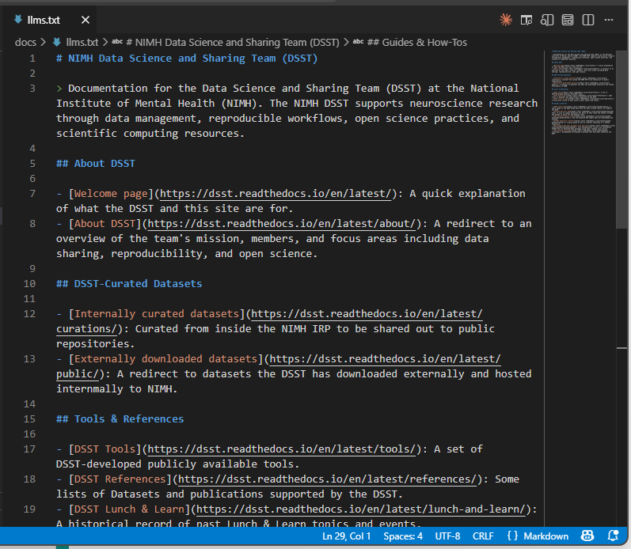
An example of using llms.txt
01 · LLMS.TXT EXAMPLE
07 / 23

Slide 8
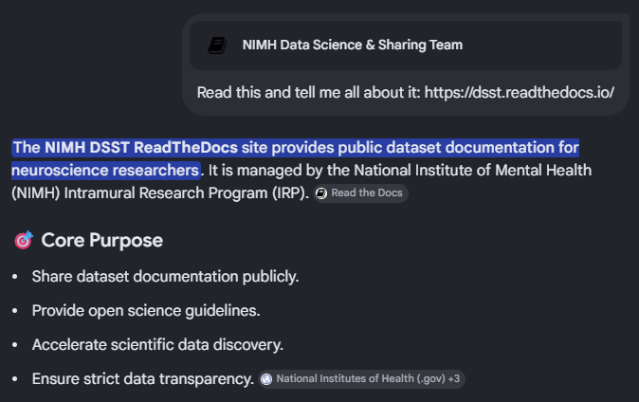
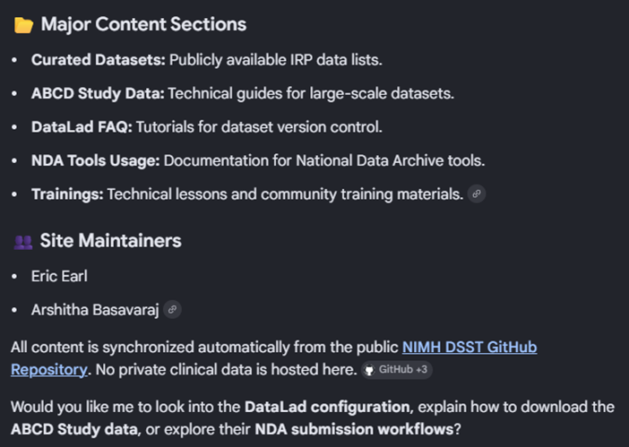
Testing an llms.txt
01 · LLMS.TXT TEST
08 / 23

Slide 9
AGENTS.md
02 · A README FOR YOUR AGENT
A markdown file at your repo root that tells the agent how this project works.
Common patterns include:
Project overview
Build & test commands
Code style guidelines
describe concisely
specify valid commands
specify language, formatter, and/or linting
Testing instructions
Security considerations
“Don’t”
when and how to test
what to avoid and/or enforce
exact things not to do
09 / 23

Slide 10
A minimal AGENTS.md
02 · AGENTS.MD SYNTAX
AGENTS.md
# Agents Guide
## Setup
- Install: `pnpm install`
- Dev server: `pnpm dev`
## Testing
- Run all tests: `pnpm test`
- Run one: `pnpm test -- path/to/file`
- Always run tests before opening a PR.
## Code style
- TypeScript strict mode is on. Don't disable it.
- Prefer named exports; default exports only for pages.
## Conventions
- Commit format: `type(scope): subject`
- Branch naming: `feature/<short-name>`
## Don't
- Don't edit files in `vendor/` or `dist/`.
- Don't add new dependencies without raising it first.
THINK OF IT LIKE
A new hire's first day
Each section answers a question someone joining the project would ask.
Reference: https://agents.md/
10 / 23

Slide 11
Writing one your agent will actually follow
02 · AGENTS.MD ADVICE
01
Be specific
02
Cover the boring stuff
Commands are better than goals
Branch names, commit format, and what not to touch
03
Treat it as living
04
Keep it short
Update it when conventions change
One screen’s worth of text, not five
11 / 23

Slide 12
AGENTS.md
02 · A REAL EXAMPLE
For my XNAT to BIDS CLI project, I decided to test this out.
A more generic AGENTS.md
https://github.com/nimh-dsst/xnat-bids-cli/blob/main/AGENTS.md
A more specific CLAUDE.md
https://github.com/nimh-dsst/xnat-bids-cli/blob/main/.claude/CLAUDE.md
12 / 23

Slide 13
Skills
03 · REUSABLE AGENT CAPABILITIES
A folder of instructions and examples the agent loads on demand — task-scoped expertise, not always-on rules.
SKILLS VS RULES
 | RULES (AGENTS.md) | SKILLS
Scope | Project-wide | Task-scoped
When loaded | Always on | Triggered by task
Format | Single .md file | Folder + SKILL.md
Best for | Conventions | Specialized capabilities
13 / 23

Slide 14
Anatomy of a Skill
03 · SKILLS SYNTAX
FILE LAYOUT
EXAMPLE SKILL.MD
tree
SKILL.md
skills/
└── skill-name/
├── SKILL.md # Required: metadata + instructions
├── scripts/ # Optional: executable code
├── references/ # Optional: documentation
├── assets/ # Optional: templates, resources
└── ... # Any additional files or directories
---
name: fill-pdf-forms
description: Use when the user
wants to fill in a PDF form
using existing field values
or a CSV input.
---
# Fill PDF Forms
## When to use
- User uploads a PDF form
- User provides field values
## How
1. Inspect fields: `fill_form.py inspect`
2. Fill with provided values
3. Save to outputs/
The folder “skill-name” is the skill. SKILL.md is the entry point.
Reference: https://agentskills.io/specification
14 / 23

Slide 15
Building a Skill
03 · SKILLS ADVICE
1
Pick a narrow capability
More fine-grained than a category.
ANTI-PATTERN
Don’t Do This
2
Write the description as a trigger
Start with "Use when…"
"general-utilities" — description: "Use for various helpful tasks."
3
Include do / don't examples
Show the shape, don't just describe it.
Too broad to trigger reliably. Split into more fine-grained skills.
Like Unix philosophy, “Do One Thing and Do It Well”
4
Test it
Hand the agent a real task.
15 / 23

Slide 16
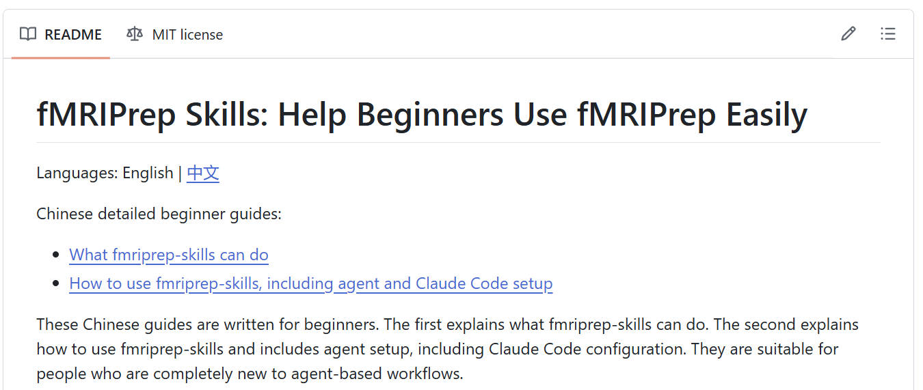
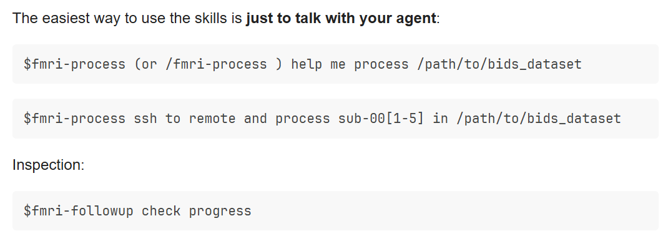
Example of a Skill
03 · SKILLS EXAMPLE
References:
https://github.com/Ascom11/fmriprep-skills
https://neurostars.org/t/ive-written-fmriprep-skills-a-lightweight-harness-to-help-beginners-use-fmriprep-more-easily/36210
16 / 23

Slide 17
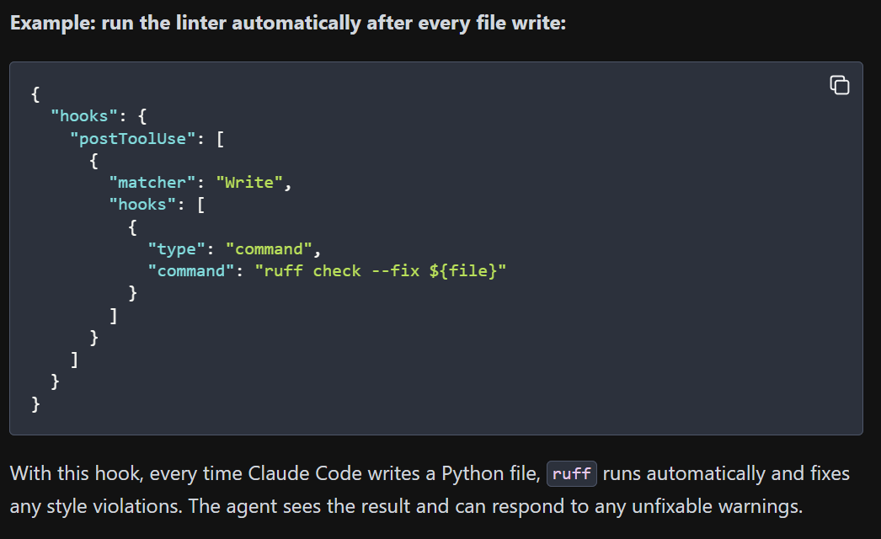
Hooks
04 · LIFECYCLE EVENTS FOR CLAUDE AGENTS
Hooks let you run shell commands automatically before or after specific agent actions. They’re defined in .claude/settings.json, at your project root, or in your global Claude Code settings.
FOUR-STEP WORKFLOW
1
Write the script
Any executable
2
Make it executable
chmod +x
3
Register in settings.json
Match by tool name
4
Restart the agent
Settings load at start
Reference: https://sagol-python-for-neuroscientists.github.io/textbook-public/classes/class_4/class_4.html
17 / 23

Slide 18
When hooks fire
04 · HOOKS (EXAMPLE DEFINITIONS)
EVENT
FIRES WHEN
UserPromptSubmit
User just sent a message
PreToolUse
Agent is about to call a tool
PostToolUse
A tool just returned
Notification
System notification fires
Stop
Agent finished its turn
PreCompact
Context is about to be compacted
Reference: https://code.claude.com/docs/en/hooks-guide#how-hooks-work
18 / 23

Slide 19
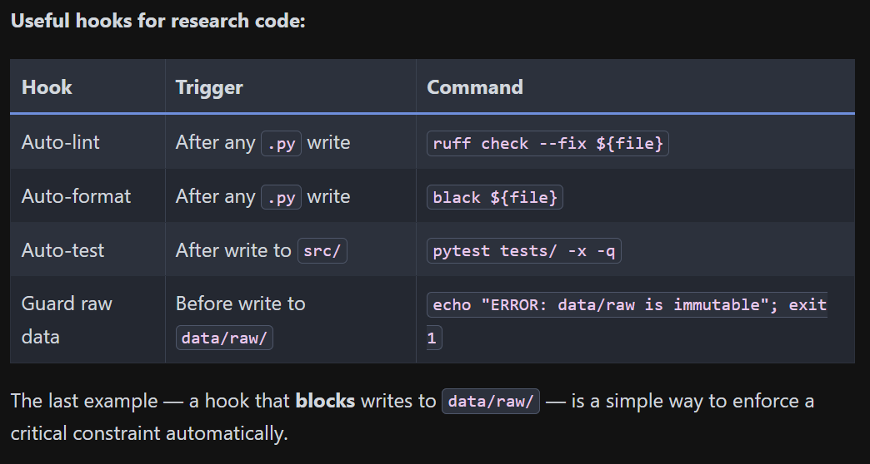
Useful hook examples
04 · HOOK EXAMPLES
Reference: https://sagol-python-for-neuroscientists.github.io/textbook-public/classes/class_4/class_4.html
19 / 23

Slide 20
Syllago
05 · WHAT IS SYLLAGO?
THE PROBLEM
THE FIX
Every tool speaks its own format
Write once, deploy everywhere
Claude Code skill
≠
Cursor rule
Define rules, skills, and hooks once
Cursor rule
≠
Windsurf rule
Syllago can translate to each provider's format
Windsurf rule
≠
Kiro steering file
Team “registries” publish standards via git
Maintain the same rule in five places? No thanks.
“Loadouts” bundle configs as apply-as-a-unit kits
20 / 23

Slide 21
Four common Syllago patterns
05 · SYLLAGO COMMANDS
01
Initialize
02
Import existing
$ syllago init
$ syllago add rules --from claude-code
Bring Syllago into a project.
Pull what you already have.
03
Cross-install
04
Pull team standards
$ syllago install my-rule --to cursor
$ syllago registry sync
Format conversion runs automatically.
One source of truth, via git.
Reference: https://syllago.dev/getting-started/quick-start/
21 / 23

Slide 22
Syllago demonstration
05 · SYLLAGO DEMO
LIVE DEMO AHEAD
What could possibly go wrong?
Syllago organizes content into three collection types:
Library holds content you own and manage directly.
Registries connect you to shared content from teams or the community.
Loadouts bundle content together so you can apply entire configurations at once.
References:
https://syllago.dev/using-syllago/tui/
https://syllago.dev/using-syllago/collections/
https://crossaitools.com/skills
22 / 23

Slide 23
Summary
WHAT WE TALKED ABOUT TODAY
✓
llms.txt
llms.txt: Markdown at your site root
✓
AGENTS.md
Global Rules: Markdown at your repo root
✓
SKILL.md
Skills: Markdown with YAML front-matter
✓
settings.json
Hooks: Claude settings JSON config file
✓
Syllago
Syllago: Git-backed, registry-published
23 / 23

